Slide 1

Information Technology 1
HE3001, Microeconomics 3 Nanyang Technological University

Slide 2
Introduction
We will now look at markets which involve information technology
Increasingly relevant given the recent rise in applications with lower costs and improved technology.
It has some special forms of externalities which generate interesting effects.
Complementarities
Network Externalities
We focus on the efficiency consequences of information technology in markets.

Slide 3



Complementarities
Commodity A complements commodity B if more of commodity A increases the value of an extra unit of commodity B.
For example:
More software increases the value of a computer.
More roads increase the value of a car.

Slide 4




Network Externalities
A commodity has a positive (negative) network externality if the utility to a consumer of that commodity increases (decreases) as more people also consume the commodity.
For example:
A social media app gives more utility to any one user if more other people use it as well.
A highway gives less utility to any one user as more people use it (congestion).

Slide 5

Review Question 1
Which of the following are good examples of complementary goods?
Onedrive and Microsoft Office
Xbox games and Xbox consoles
Iphones and Google services
Which of the following are good examples of goods with network externalities?
Microsoft Office
A single player video game
Tiktok
Youtube

Slide 6
Complementarities in Information Technology

Slide 7
IT & Complementarities
Information technologies are technologies which create, process, store, retrieve, and exchange all kinds of electronic data and information.
This digitalisation of information has greatly increased complementarities between commodities.
Computers and operating systems (OS)
DVD players and DVD disks
Wi-Fi sites and laptop computers
Cell phones and cell phone towers

Slide 8
Complementarity & Externalities
What happens when a firm produces a commodity that complements another commodity?
Suppose that when Firm A makes more of its product (commodity A), it increases the value of firm B’s product (commodity B). These are like externalities!
What will outcomes be like under standard competition?
Intuitively, from what we learnt before, this should lead to some inefficiencies…
We will discuss this in the context of a simple model.

Slide 9
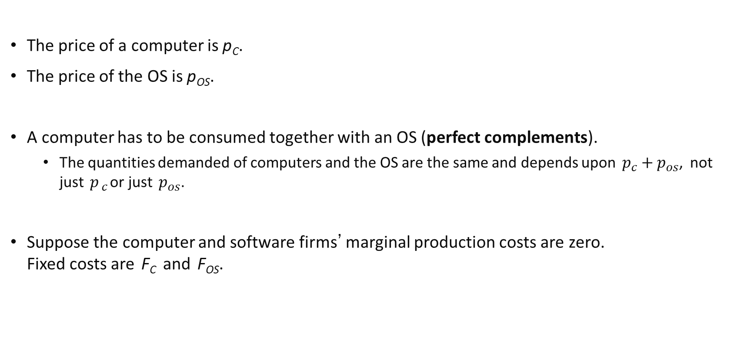
Complementarity & Competition: Example
The price of a computer is p_{C}.
The price of the OS is p_{OS}.
A computer has to be consumed together with an OS (perfect complements).
The quantities demanded of computers and the OS are the same and depends upon $p_{c}+p_{os}$, not just $p_{c}$or just $p_{os}$.
Suppose the computer and software firms’ marginal production costs are zero. Fixed costs are F_{C} and F_{OS}.
Notes:
Demand depends on p_{C} + p_{OS} because these are purchased together in a one-to-one ratio. So, the overall cost of the computer with operating software package is p_{C} + p_{OS.}

Slide 10
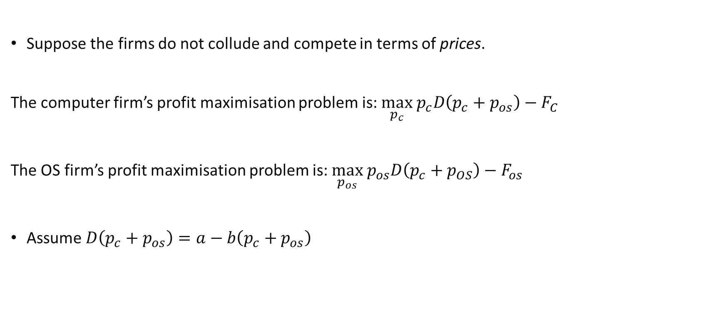
Complementarity & Competition: Example
Suppose the firms do not collude and compete in terms of prices.
The computer firm’s profit maximisation problem is:$\max_{p_{c}} p_{c}D\left(p_{c}+p_{os}\right)−F_{C}{ }$
The OS firm’s profit maximisation problem is:$\max_{p_{os}} p_{os}D\left(p_{c}+p_{OS}\right)−F_{os}{ }$
Assume $D\left(p_{c}+p_{os}\right)=a−b\left(p_{c}+p_{os}\right)$

Slide 11

Complementarity & Competition: Example
Solving the profit maximisation problem of each firm to get their best response functions:
$$p_{c}=\frac{a−bp_{os}}{2b}$$
$$p_{os}=\frac{a−bp_{c}}{2b}$$
The Nash Equilibrium is $p_{c}^{∗}=p_{os}^{∗}=\frac{a}{3b}$. $q_{c}^{∗}=q_{os}^{∗}=a−b\frac{2a}{3b}=\frac{a}{3}$
Total revenue= $\frac{a}{3}×\frac{a}{3b}× 2=\frac{2a^{2}}{9b}$

Slide 12
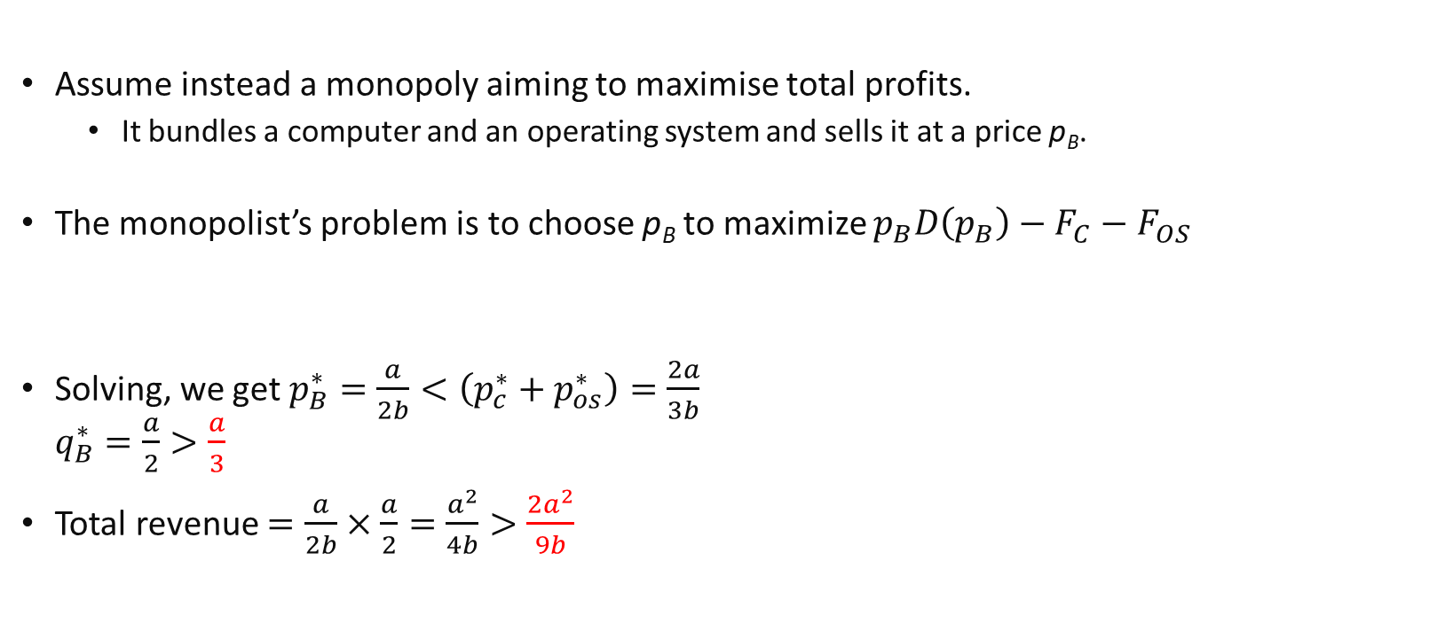
Complementarity: Monopoly
Assume instead a monopoly aiming to maximise total profits.
It bundles a computer and an operating system and sells it at a price p_{B}.
The monopolist’s problem is to choose p_{B} to maximize $p_{B}D\left(p_{B}\right)−F_{C}−F_{OS}$
Solving, we get $p_{B}^{∗}=\frac{a}{2b}<\left(p_{c}^{∗}+p_{os}^{∗}\right)=\frac{2a}{3b}$ $q_{B}^{∗}=\frac{a}{2}>\frac{a}{3}$
Total revenue $=\frac{a}{2b}×\frac{a}{2}=\frac{a^{2}}{4b}>\frac{2a^{2}}{9b}$
Notes:
Note: a one to one bundle is the correct assumption, otherwise there is wastage.

Slide 13
Complementarity and Inefficiency
Compared to the monopoly,
Competing firms supply less computers and OS at a higher price
Competing firms also have less total revenue (and profits)
Paradoxically, competition is worse for everyone! Why? A problem of externalities!
The noncooperative firms ignore the external benefit (complementarity) each creates for the other. So, each undersupplies the market, causing a higher market price.
These externalities are fully internalized in the merged firm, inducing it to supply more computers and OS and thereby cause a lower market price.

Slide 14
Solutions to complementarity problems
Such inefficiencies may be solved if Firm A can get some of the gain it creates for Firm B.
An obvious strategy as hinted in lecture 7 would be to negotiate a merger between firms A and B.
Alternatively, firms A and B can agree to cooperate somewhat with each other.
Microsoft releases part of its OS to firms making software that runs under its OS.
DVD manufacturers agree upon a standard format for their disks.

Slide 15
Solutions to complementarity problems
More typical cooperation consists of contracts between component manufacturers and an assembler of a final product.
E.g. car components and a car assembler, a computer assembler and manufacturers of CPUs, hard drives, memory chips, etc.
Some examples of contracts include:
Revenue sharing: two firms share the revenue from the final product made up from the two firms’ components. One firm sets the combined price.
Licensing: let firms making complements to your product use your technology for a low fee so they make large quantities of complements, thereby increasing the value of your product to consumers.
Idea: Better to have a small share of a large successful industry, than a large share of a small industry.

Slide 16
Review Question 2
Assume that firms compete via prices as before.
In a market with 2 firms, whose products are (perfect) complements, how does social welfare (producer and consumer surplus) compare to a monopoly scenario? - Lower
In a market with 2 firms, whose products are (perfect) substitutes, how does social welfare (producer and consumer surplus) compare to a monopoly scenario? - Higher

Slide 17
Network Externalities in Information Technology

Slide 18
IT & Network Externalities
Information technologies and the internet in particular, also create greater scope for network externalities.
The digitalisation of information and ease of sharing between people means that there are greater benefits from more people using a common system.
Social Networks
Communications platforms
Media sharing platforms

Slide 19
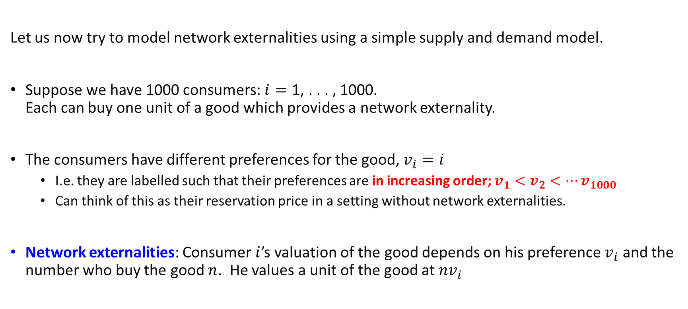
Network Externalities: an Example
Let us now try to model network externalities using a simple supply and demand model.
Suppose we have 1000 consumers: $i=\text{1, . . . , 1000}\text{.}$ Each can buy one unit of a good which provides a network externality.
The consumers have different preferences for the good, $v_{i}=i$
I.e. they are labelled such that their preferences are in increasing order; $v_{1}<v_{2}<…v_{1000}$
Can think of this as their reservation price in a setting without network externalities.
Network externalities: Consumer $i$’s valuation of the good depends on his preference $v_{i}$ and the number who buy the good $n$. He values a unit of the good at ${nv}_{i}$

Slide 20

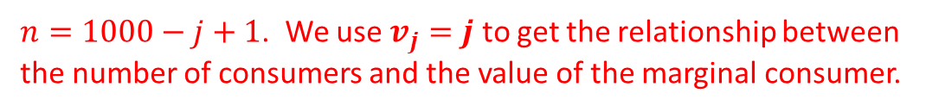


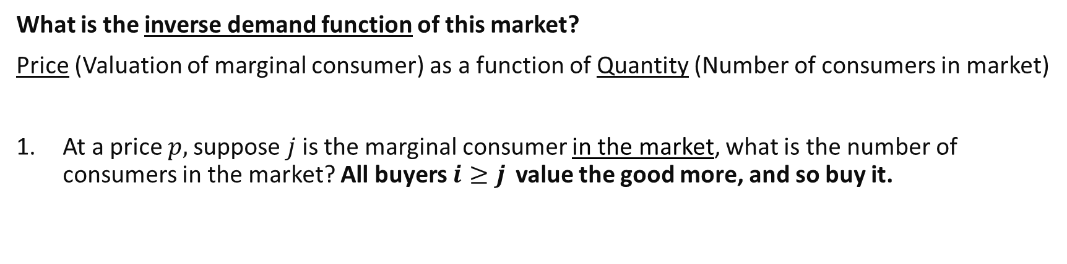






Network Externalities: an Example
What is the inverse demand function of this market?
Price (Valuation of marginal consumer) as a function of Quantity (Number of consumers in market)
At a price $p,$suppose $j$ is the marginal consumer in the market, what is the number of consumers in the market? All buyers $i≥j$ value the good more, and so buy it.
$$v_{1}$$
$$v_{2}$$
$$v_{3}$$
….
$$v_{j}$$
$$v_{j+1}$$
$$v_{j+2}$$
….
$$v_{999}$$
$$v_{1000}$$
$1000−v_{j}$ people
Quantity demanded is $n=1000−v_{j}+1$ (Including j)
$n=1000−j+1$. We use $v_{j}=j$ to get the relationship between the number of consumers and the value of the marginal consumer.

Slide 21
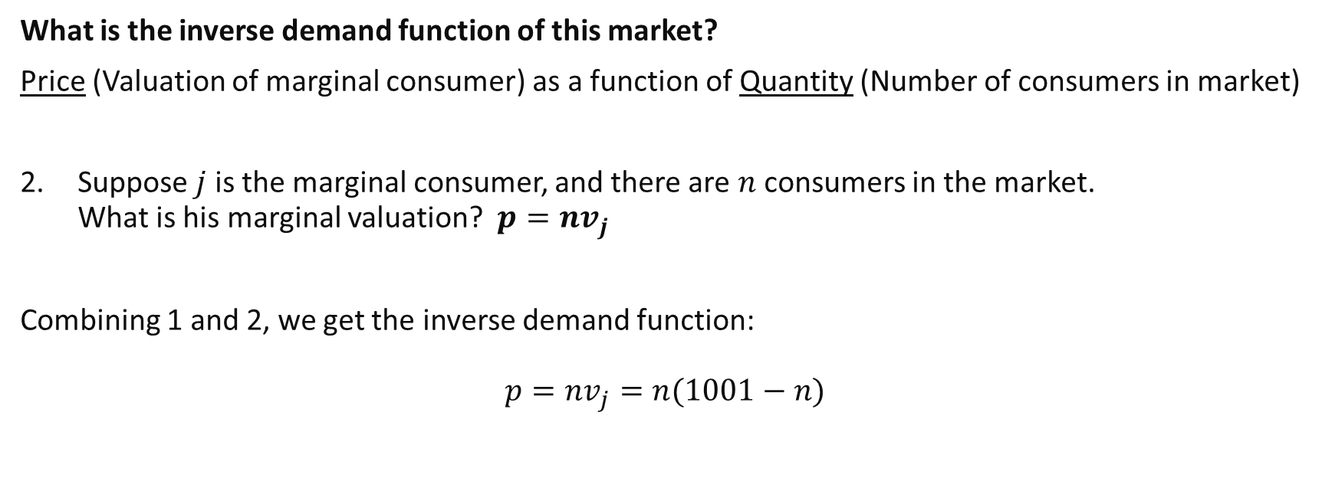
Network Externalities: an Example
What is the inverse demand function of this market?
Price (Valuation of marginal consumer) as a function of Quantity (Number of consumers in market)
Suppose $j$ is the marginal consumer, and there are $n$ consumers in the market. What is his marginal valuation?$p=nv_{j}$
Combining 1 and 2, we get the inverse demand function:
$$p=nv_{j}=n(1001−n)$$
Food for thought: What if instead $v_{i}=2i$?

Slide 22
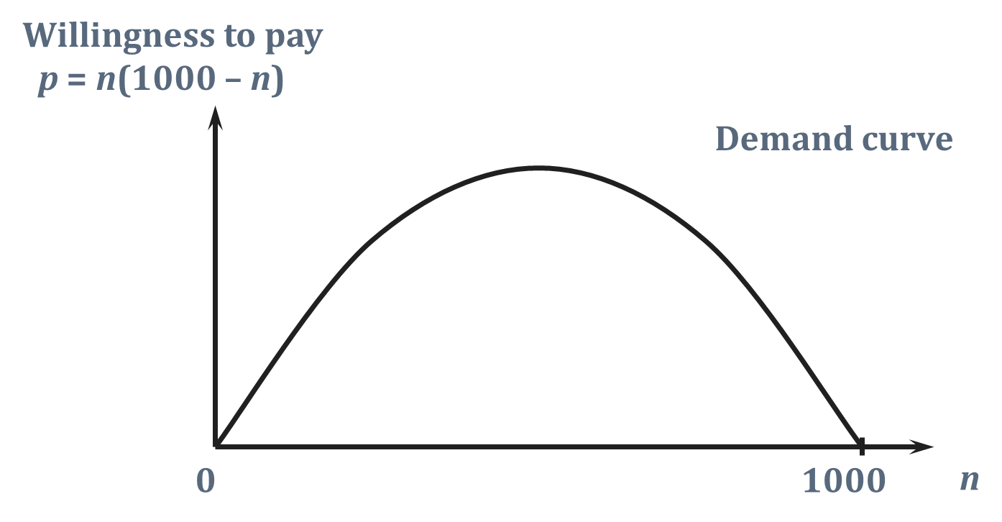

Network Externalities: an Example
$$p=n(1001−n)$$
1001

Slide 23
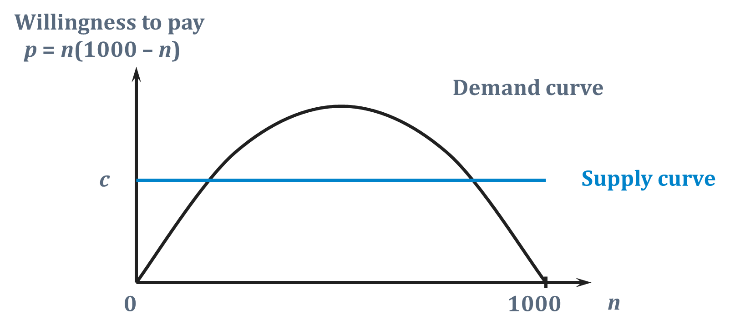
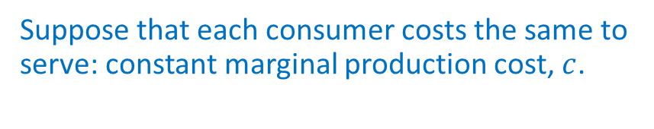
Network Externalities: an Example
Suppose that each consumer costs the same to serve: constant marginal production cost, $c$.
$$p=n(1001−n)$$
1001

Slide 24
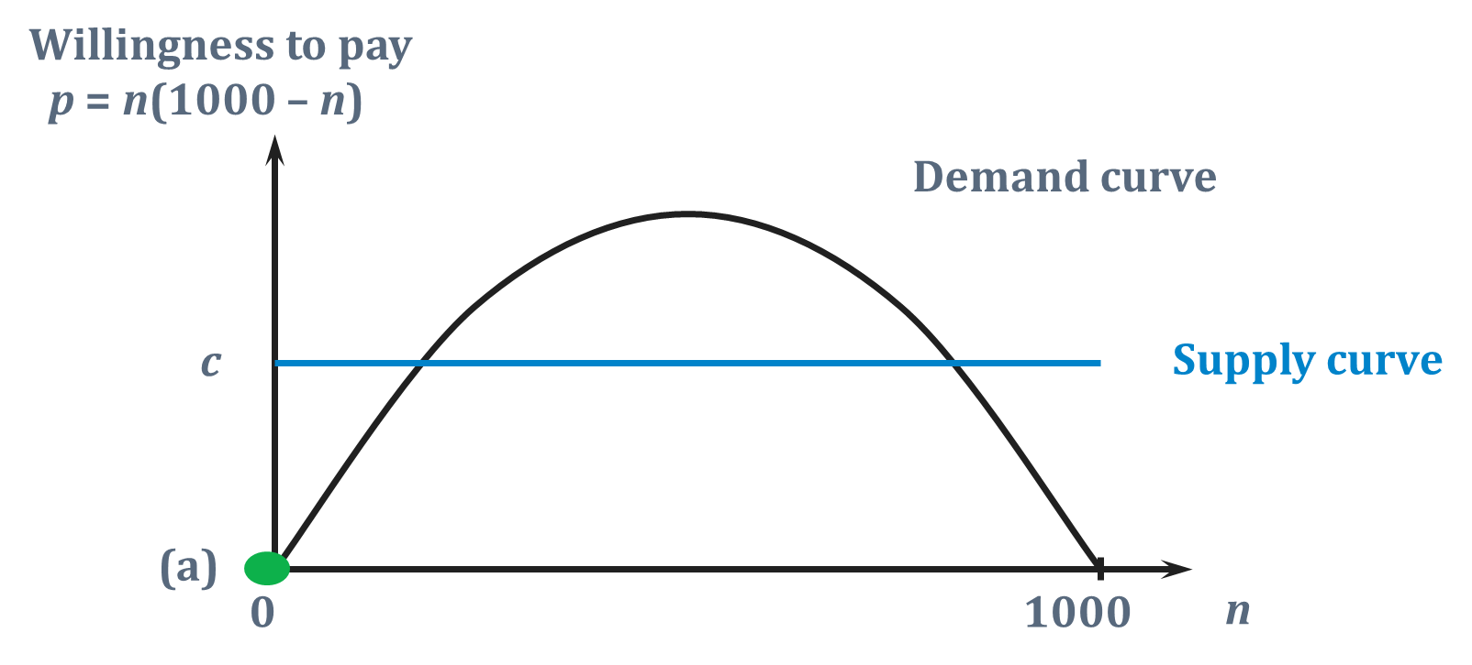
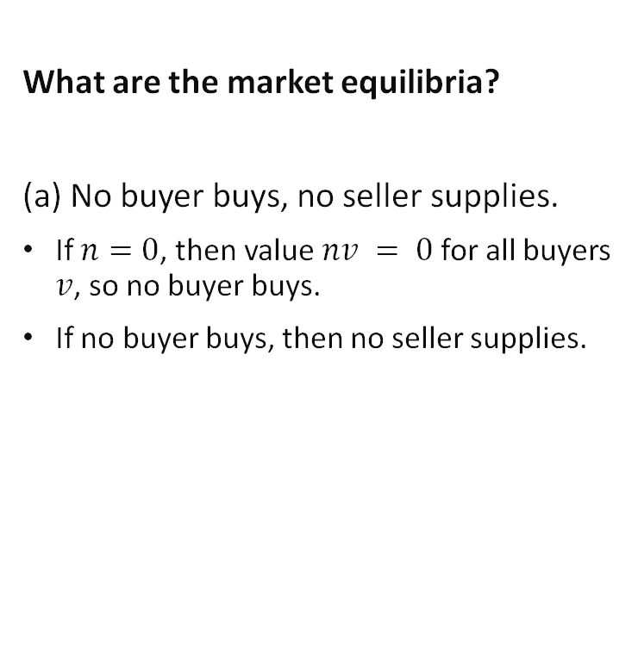

Network Externalities: an Example
What are the market equilibria?
(a) No buyer buys, no seller supplies.
If $n=0$, then value $nv = 0$ for all buyers $v$, so no buyer buys.
If no buyer buys, then no seller supplies.
$$p=n(1001−n)$$
1001
1001
Notes:
Can think of this as supply vertically jumping up from 0 at n=0

Slide 25
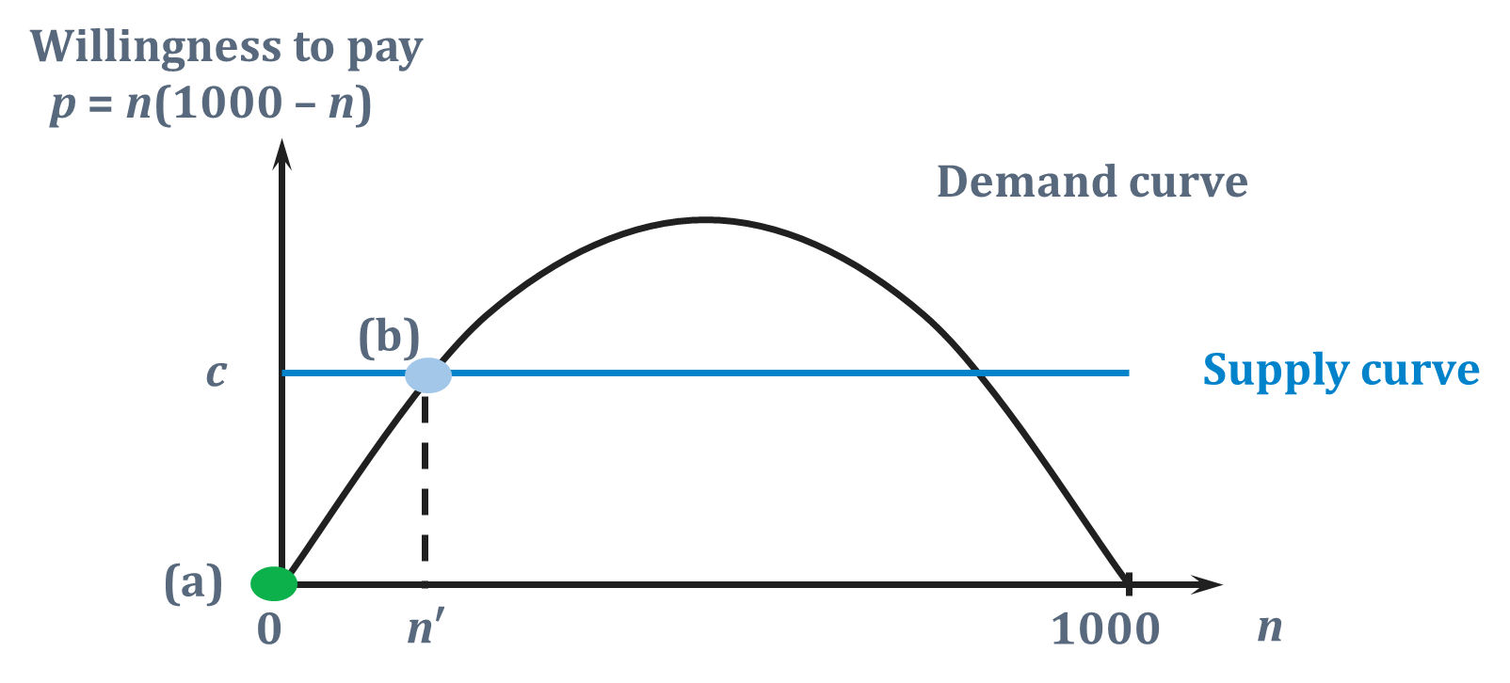
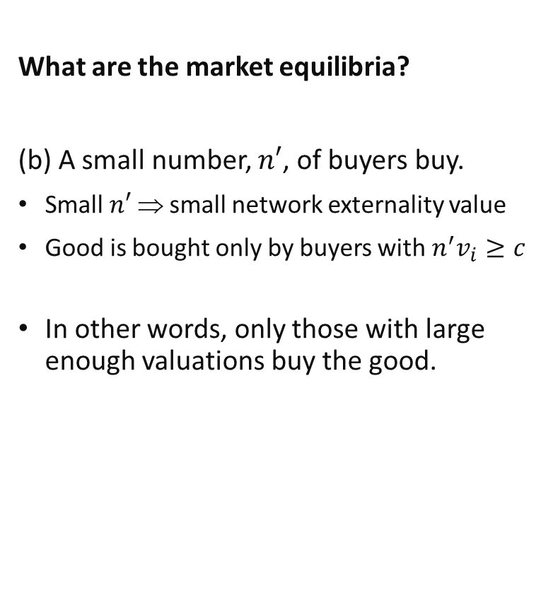

Network Externalities: an Example
What are the market equilibria?
(b) A small number, $n′$, of buyers buy.
Small $n′$ ⇒ small network externality value
Good is bought only by buyers with $n^{′}v_{i}≥c$
In other words, only those with large enough valuations buy the good.
$$p=n(1001−n)$$
1001

Slide 26
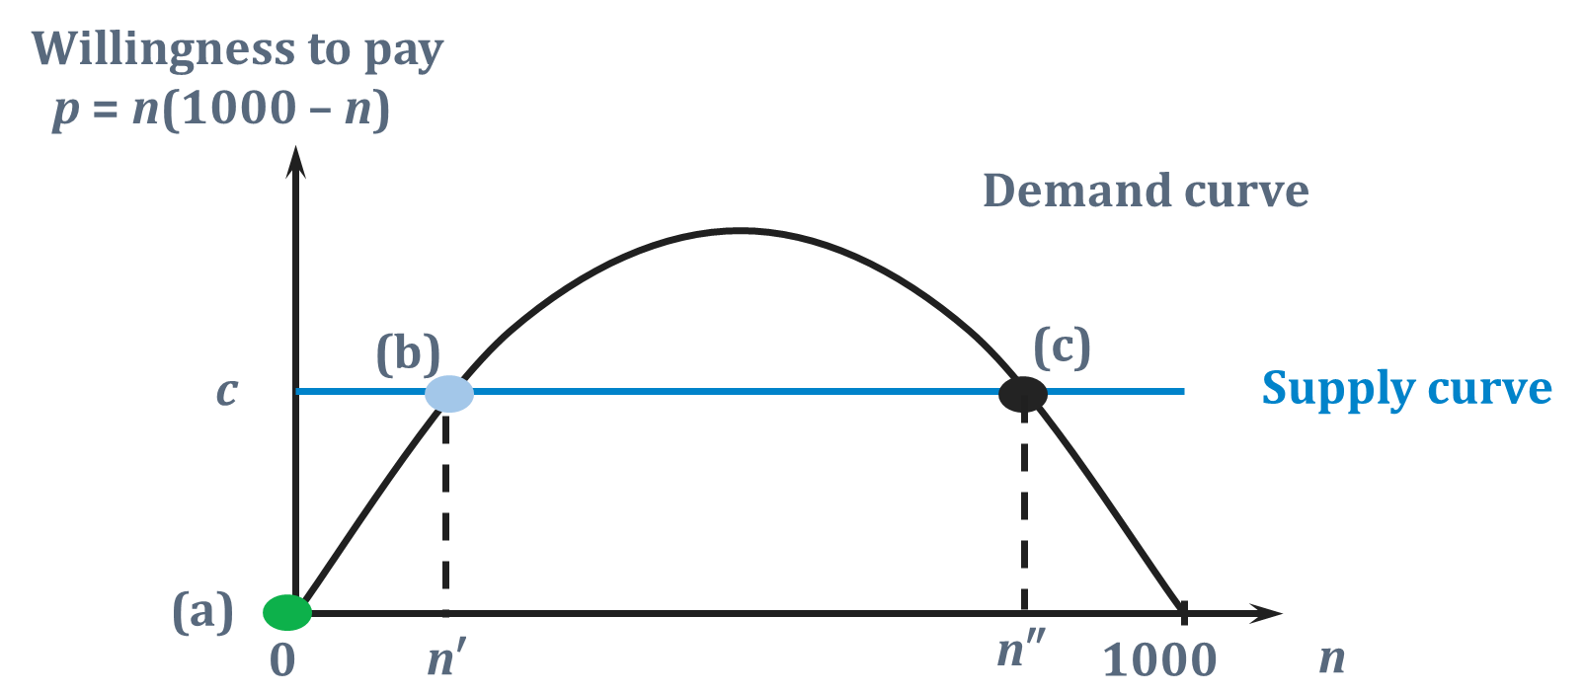
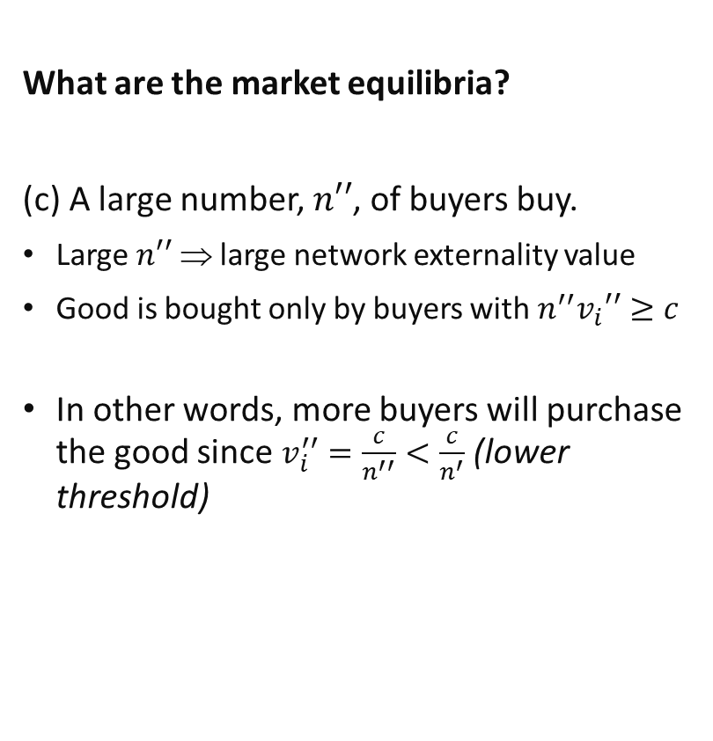

Network Externalities: an Example
What are the market equilibria?
(c) A large number, $n′′$, of buyers buy.
Large $n′′$ ⇒ large network externality value
Good is bought only by buyers with $n^{′′}v_{i}′′≥c$
In other words, more buyers will purchase the good since $v_{i}^{′′}=\frac{c}{n^{′′}}<\frac{c}{n^{′}}$ (lower threshold)
$$p=n(1001−n)$$
1001

Slide 27






Network Externalities: an Example
Network externalities can lead to multiple equilibria in the market.
In some, the market will not exist, while in others there is large usage (and high benefits).
Which of these outcomes can we expect to see in the market and how can we model the dynamics in the market?
It is possible to narrow down on the outcomes by focusing on the stability of each equilibria.
Let us say that an equilibrium is (locally) stable if there exists some region around it for which any small random shocks within it still result in convergence to the same equilibrium.
$$x$$
$$x$$
$x$ increases here
$x$ decreases here
$x$ decreases here
$x$ increases here
Stable
Unstable

Slide 28
Network Externalties: Market Dynamics

Slide 29
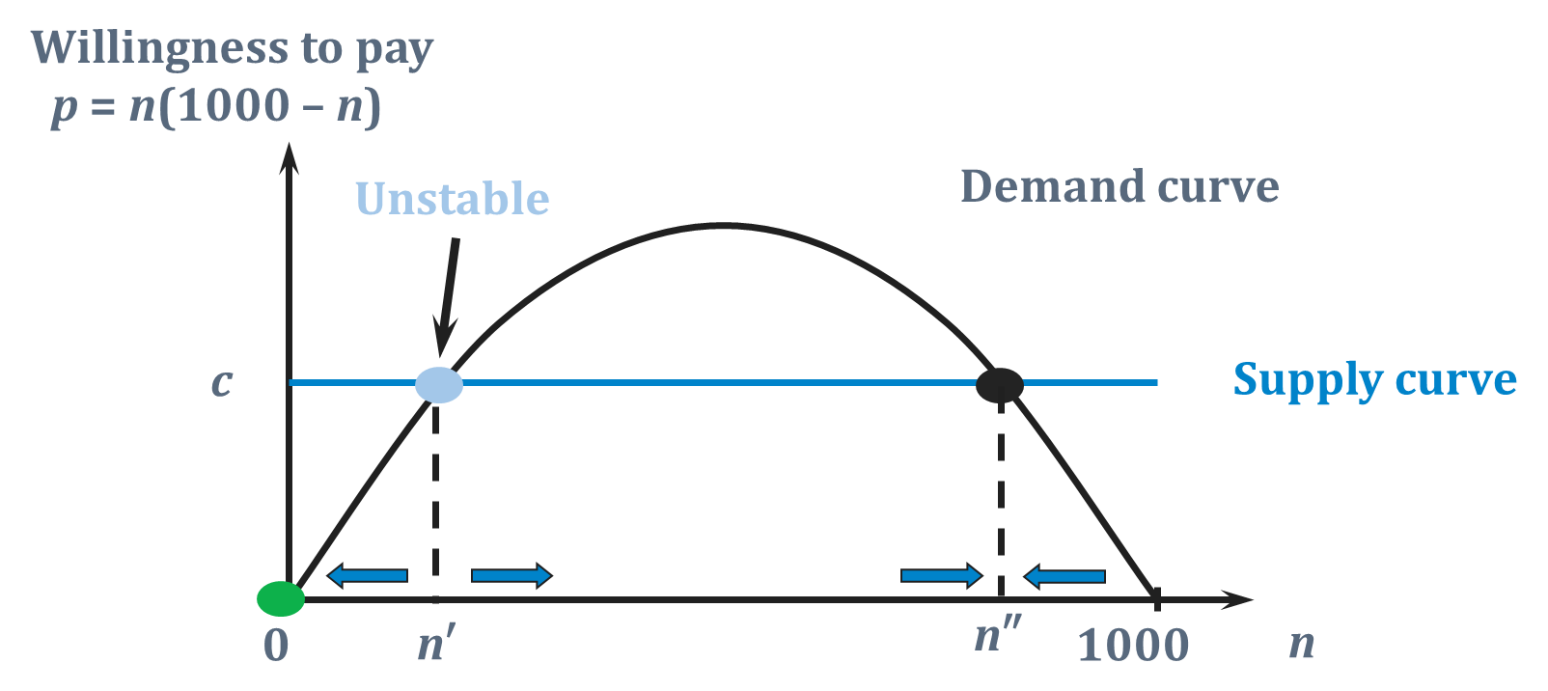

Network Externalities: Dynamics
Suppose the market expands whenever willingness to pay exceeds marginal production cost, c and vice versa.
$$p=n(1001−n)$$
1001

Slide 30
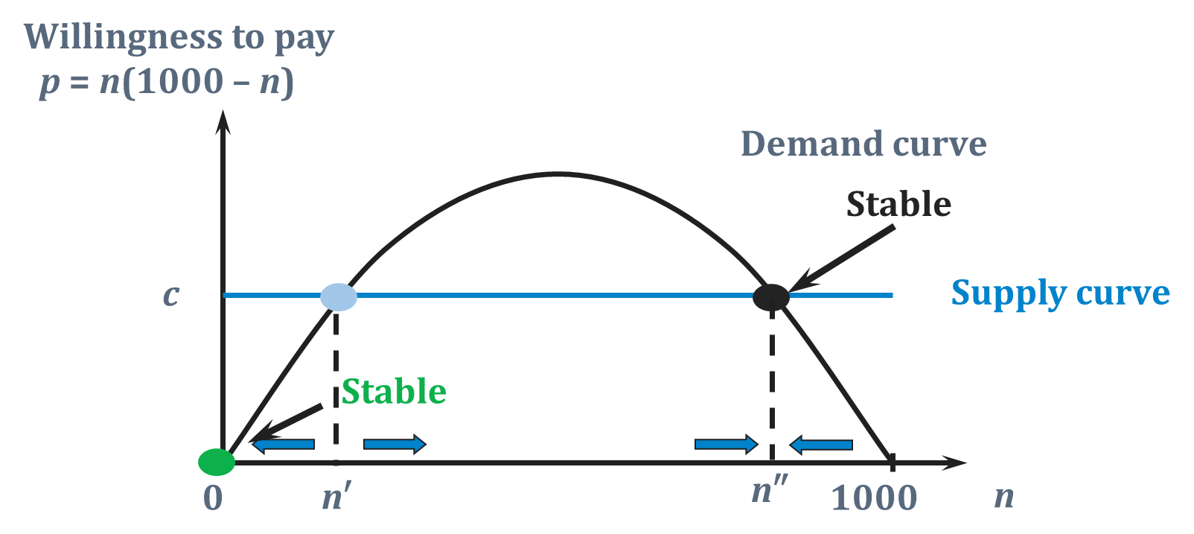
Network Externalities: Dynamics
Suppose the market expands whenever willingness to pay exceeds marginal production cost, c and vice versa.
$$p=n(1001−n)$$
1001

Slide 31

Network Externalities: Stability
As you can see, there are two main stable equilibria in this scenario with network externalities:
No consumption of the good
High consumption of the good
Intuitively, this is because there are two effects on marginal valuation, $p=n(1001−n)$ when $n$ increases:
Network externalities raises the valuation for others. ($+$)
The next marginal consumer has lower valuation. ($−$)
Which effect is larger depends on the level of $n$:
When inverse demand is upward sloping: $+ve≻−ve$
When inverse demand is downward sloping: $−ve>+ve$

Slide 32
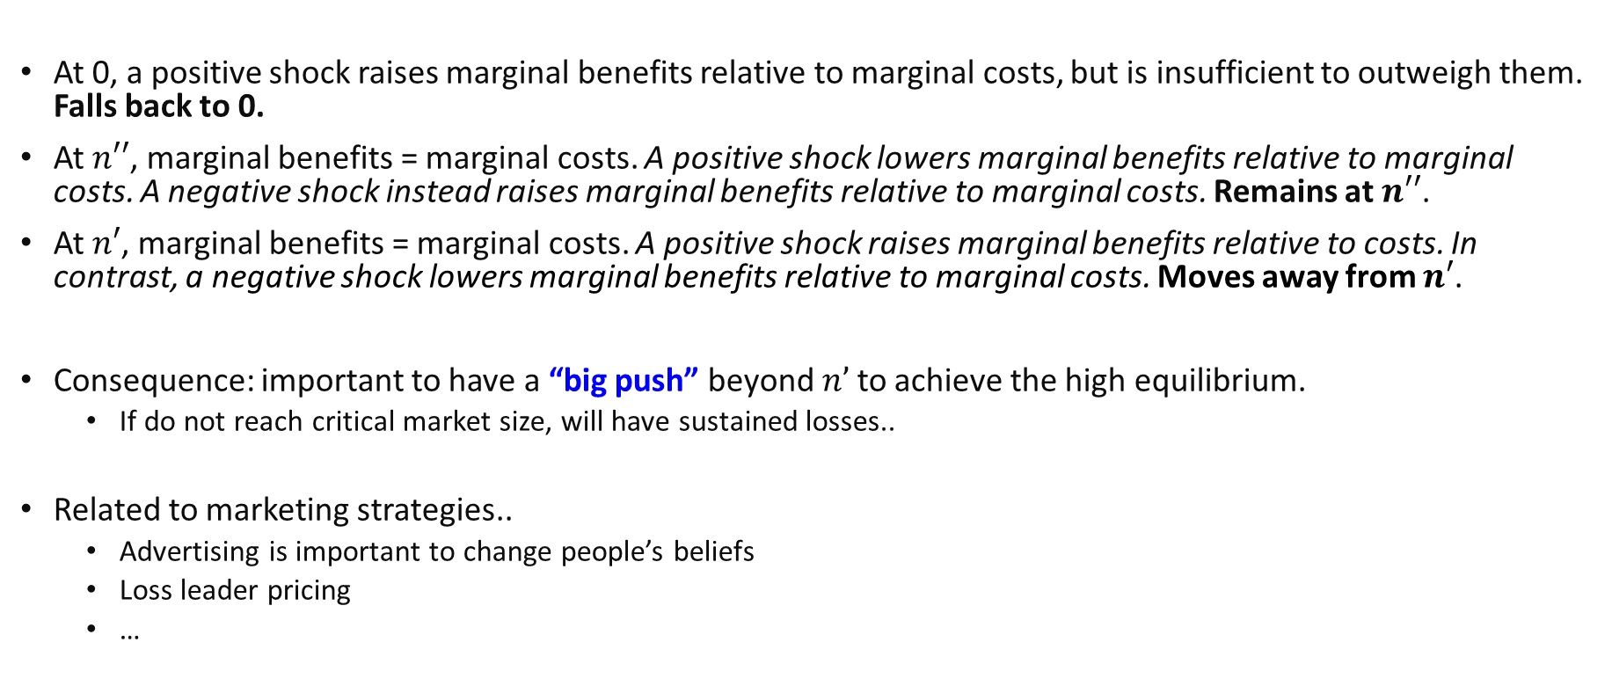
Network Externalities: Stability
At 0, a positive shock raises marginal benefits relative to marginal costs, but is insufficient to outweigh them. Falls back to 0.
At $n′′$, marginal benefits = marginal costs. A positive shock lowers marginal benefits relative to marginal costs. A negative shock instead raises marginal benefits relative to marginal costs. Remains at $n′′$.
At $n′$, marginal benefits = marginal costs. A positive shock raises marginal benefits relative to costs. In contrast, a negative shock lowers marginal benefits relative to marginal costs. Moves away from $n′$.
Consequence: important to have a “big push” beyond $n’$to achieve the high equilibrium.
If do not reach critical market size, will have sustained losses..
Related to marketing strategies..
Advertising is important to change people’s beliefs
Loss leader pricing
…
Notes:
Marginal benefits is captured by the marginal valuations.

Slide 33

Review Question 3
Willingness to pay
Demand curve
Supply curve
A
B
C
D
E
$$n$$
Consider the above fictional perfectly competitive market. Suppose it expands whenever willingness to pay exceeds marginal production costs, c and vice versa. Which of the above are stable market equilibria?
B and D

Slide 34
Network externalities in Two sided markets

Slide 35
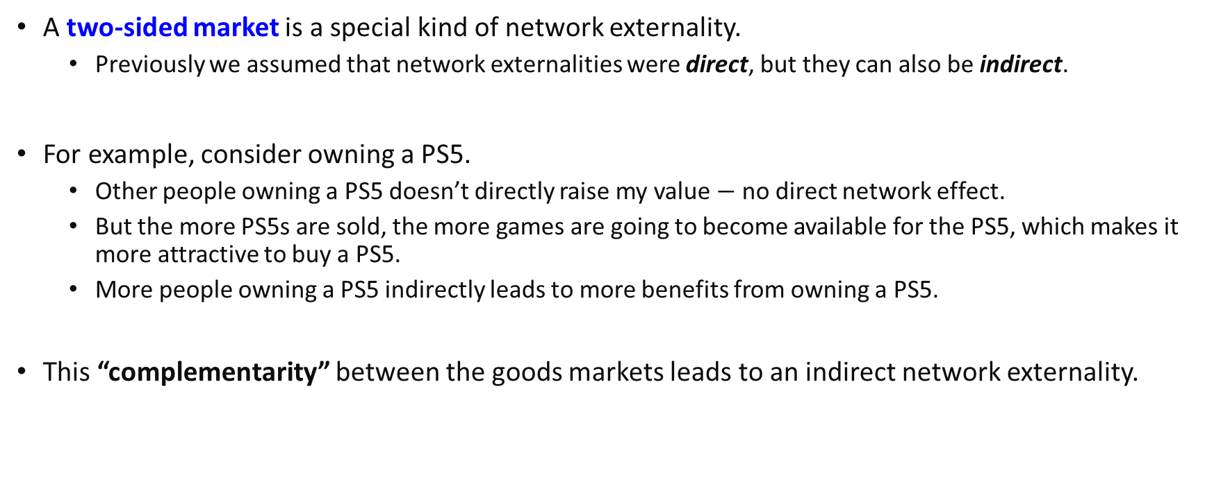
Two-sided markets
PS5
Games
A two-sided market is a special kind of network externality.
Previously we assumed that network externalities were direct, but they can also be indirect.
For example, consider owning a PS5.
Other people owning a PS5 doesn’t directly raise my value $−$ no direct network effect.
But the more PS5s are sold, the more games are going to become available for the PS5, which makes it more attractive to buy a PS5.
More people owning a PS5 indirectly leads to more benefits from owning a PS5.
This “complementarity” between the goods markets leads to an indirect network externality.

Slide 36
Two-sided markets
Network externalities in two sided markets result in similar outcomes to that from standard network externalities.
More on models of two-sided markets next week.
Other examples:
iPhones and iTunes store.
New media formats and media players. (CD, DVD, BluRay…)

Slide 37
Key Learning Outcomes
How to model information technology in markets?
Complementarities
Network externalities
Effects on efficiency in such markets.
Need to know how to analyse equilibrium outcomes.
Consequences for the structure of policies to improve social welfare.

Slide 38
Readings
Varian Chapter 36
Has many real-life examples, albeit outdated..
Dynamic Strategies: https://timharford.com/2023/03/the-enshittification-of-apps-is-real-but-is-it-bad/

